Slide 1

Lightweight Mouth Movement Detection (Talking vs Not Talking)
By Jack DeMarinis
Notes:
This project builds a lightweight mouth-movement detector that classifies talking versus not talking in real time. It runs on standard CPU hardware and uses facial landmarks plus a compact neural network.

Slide 2

Motivation
Why visual speech detection?
Audio diarization fails with cheap microphones
Overlapping speech confuses STT models
Visual motion stays reliable
Needed for my LLM meeting-summary tool
Notes:
The motivation came from my LLM-powered meeting-summarization tool. In real meetings, people use low-quality microphones, leading to bad speaker diarization. Overlapping speech also breaks audio-based methods. Visual mouth motion is much more reliable. So this mouth-movement model is meant to be a complementary signal to help the diarization pipeline become far more accurate.

Slide 3
The Idea
Binary talking/not-talking classifier
Facial-landmark feature pipeline
Custom NumPy neural network
Real-time CPU inference
Lightweight Real-Time Mouth Movement Detection
Notes:
Hi everyone, I’m Jack DeMarinis, and this is my lightweight mouth-movement detection system. It predicts talking versus not talking using only features extracted from facial landmarks. I built the neural network entirely in NumPy, and the whole thing runs in real time on CPU. Today I’ll go through the motivation, data, model, training results, and show a live demo of the final system.

Slide 4
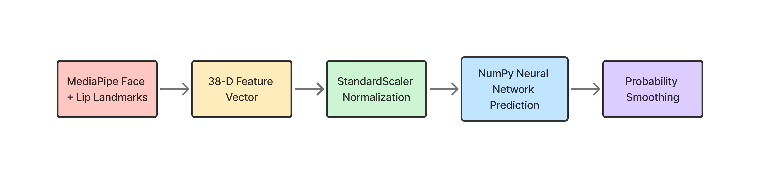
Processing Pipeline
Full end-to-end system
Notes:
The pipeline starts with MediaPipe for facial landmarks. From those landmarks and surrounding patches, I compute a 38-dimensional feature vector. The vector is normalized and passed to my NumPy neural network. I then smooth the output over a short window to prevent prediction flicker.

Slide 5
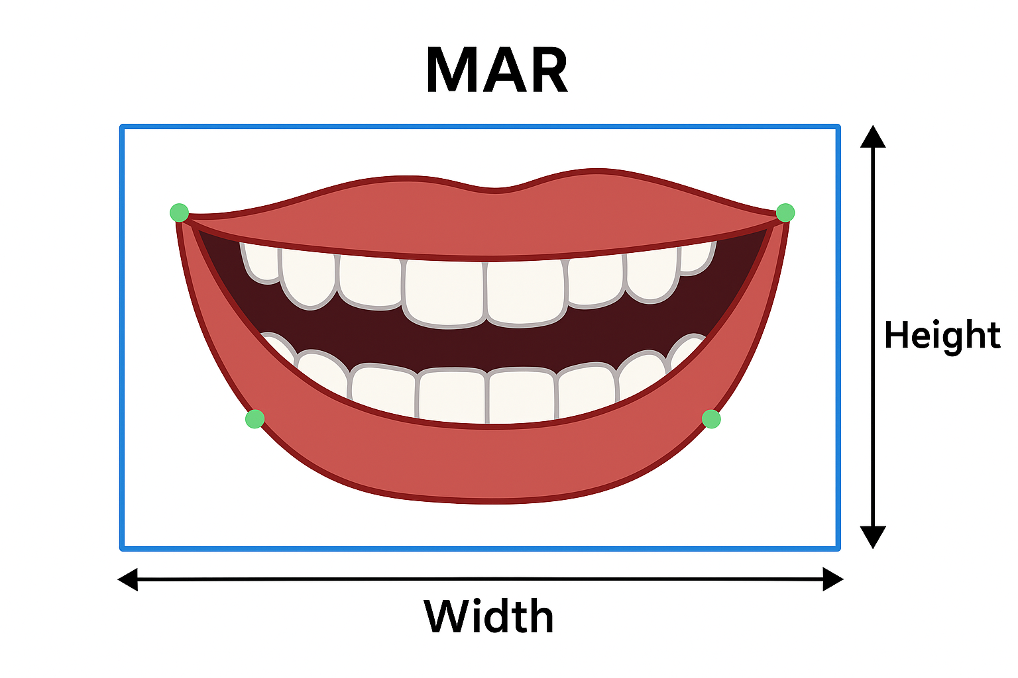
Feature Engineering
Rich structured features
Geometry: MAR, width, height
Temporal motion differences
Pixel intensity statistics
Edge/gradient magnitudes
Normalized landmark subsets
Notes:
The feature vector mixes geometry, motion, and texture. That includes the mouth aspect ratio, lip spread, frame-to-frame landmark motion, intensity statistics in the mouth region, and gradient energy. I also add normalized landmark subsets for spatial structure.

Slide 6
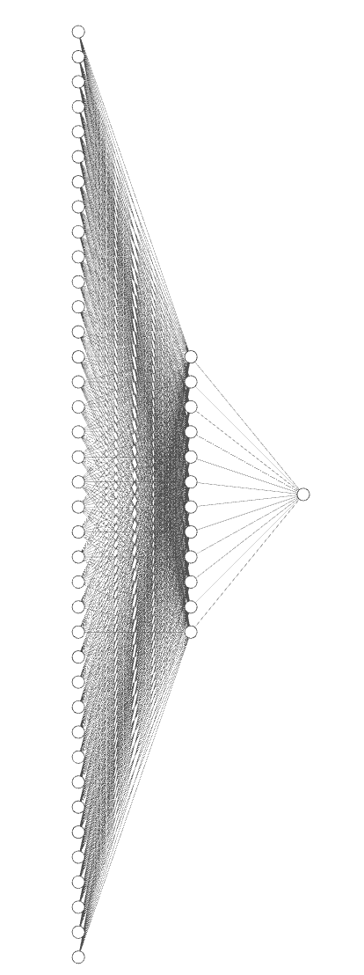
Neural Architecture
Feedforward NN (38 → 12 → 1)
Implemented fully in NumPy
Sigmoid hidden + output layers
Weighted BCE + L2 regularization
Pos-weight improves recall
Notes:
The network is intentionally tiny: 38 inputs, 12 hidden units, one sigmoid output. I implemented all forward- and back-prop logic by hand in NumPy. Training uses weighted BCE and L2 regularization. I also use a positive-class weight to boost talking-frame recall.

Slide 7

Dataset Overview
Frame-level labeled data
Captured about 7000 webcam frames
Labels: talking (1) vs not talking (0)
Feature extraction performed per frame
Metadata stored in CSV
Notes:
I captured labeled frames from my webcam using a custom tool. Each frame is tagged as talking or not talking. All the data paths and labels are stored in a simple CSV. I never train on raw pixels — everything goes through the feature extractor first.

Slide 8

Training Setup
Full training pipeline
Stratified train/val/test split
  Train: 70%
  Validation: 15%
  Test: 15%
Early stopping on validation loss
Batch size 32, LR 0.05
Metric tracking across 200 epochs
Notes:
I used stratified splits to keep class proportions stable across training, validation, and test. Training uses mini-batches of 32, a learning rate of 0.05, and early stopping to avoid overfitting. All metrics were logged across the 200 epochs.

Slide 9

Class Imbalance
Imbalance in collected data
More non-talking frames present
Bias pushed model toward negatives
Talking recall suffered
Required balancing strategies
Notes:
When I inspected the data, it was very imbalanced: way more not-talking frames. The model immediately biased toward predicting silence. That tanked recall on talking frames. Since missing speech is unacceptable, I needed better balance.

Slide 10
Augmentation and Weighting
Balancing talking frames
Duplicated talking samples
  Horizontal flips, color jitter
Weighted BCE + positive-class weighting boosted talking recall
Reduced class imbalance
Notes:
To fix the class imbalance, I used my augmentation script to duplicate talking frames with small transformations like flips and color jitter. This boosted the number of positive examples without distorting the mouth geometry. I also added a positive-class weight to the loss function, which forces the model to penalize missed talking frames more heavily. Together, these two changes significantly improved recall and made the model much more responsive to actual speech activity.

Slide 11
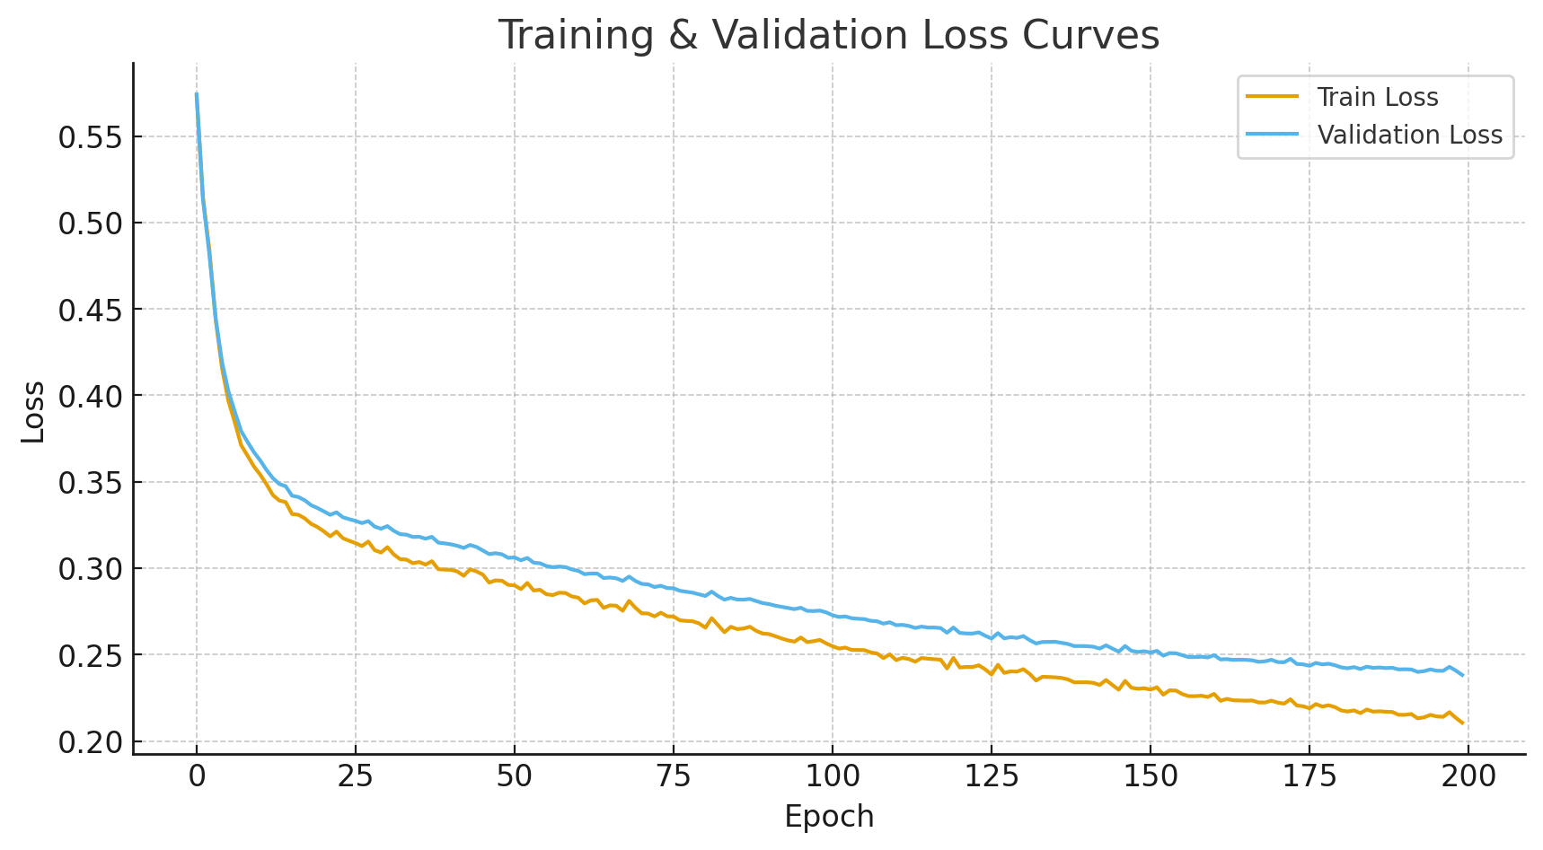
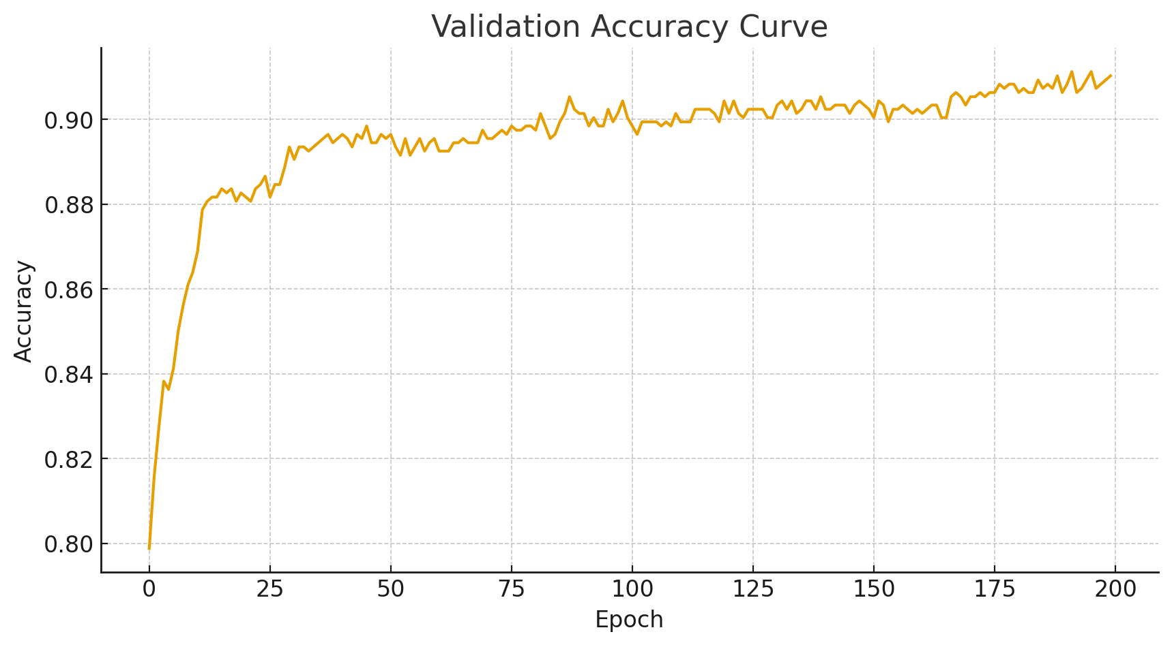
Training Curves
Stable convergence
Training/validation losses aligned
High validation accuracy
No major overfitting
Smooth learning trajectory
Notes:
The loss curves show smooth convergence with validation accuracy staying high throughout. There’s no divergence or instability. That gave me confidence to move forward to testing.

Slide 12
Final Metrics
Test-set performance
Accuracy: 91.7%
Precision: 89.3%
Recall: 88.0%
F1 score: 88.6%
>= 30 FPS inference
Notes:
On the held-out test set, the model reached 91.7 percent accuracy, 89.3 percent precision, 88 percent recall, and an F1 of 88.6. This shows the model can reliably detect speech activity and isn’t just exploiting class imbalance.

Slide 13
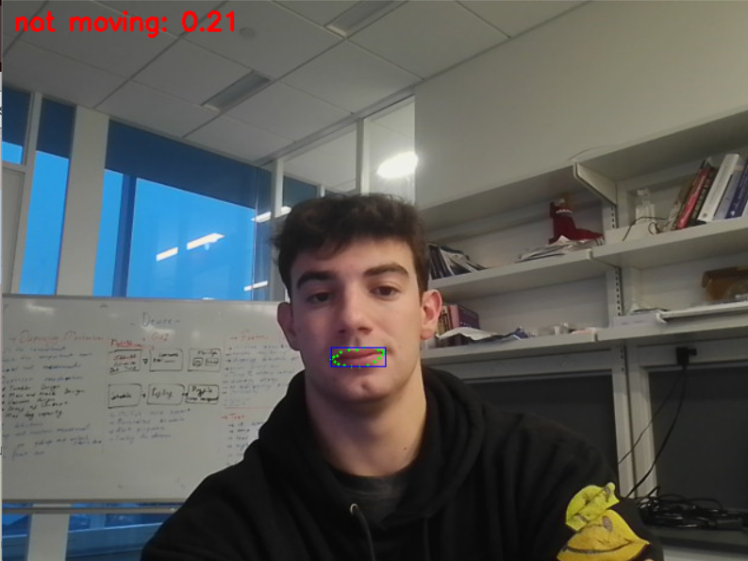
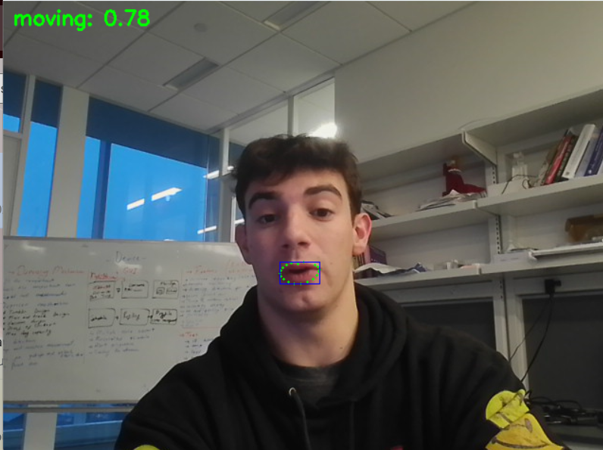
Testing
Notes:
It works!

Slide 14

Challenges & Future Work
Improvement opportunities
Landmark failures at large angles
Low-light sensitivity remains
Training data had only two lighting/range setups
Need multi-range, multi-lighting data
Add on-screen prompts for ideal distance/angle
Use different configurations
Notes:
One big limitation was my training data. I only collected data in two similar environments with nearly identical lighting and distance. I noticed the model performs worse when someone is significantly closer or farther from the camera than in training. A future version should include multiple distances, angles, and lighting setups so the landmark and feature distributions generalize better. Another idea is to add an on-screen guidance prompt telling the user to move closer or farther from the camera to reach the ideal detection range. Beyond that, more robust temporal models and lighting-invariant augmentation would help the system generalize to real-world meeting environments.

Slide 15
Conclusion
Summary
Lightweight and fast classifier
Strong test metrics
Real-time CPU inference
Practical module for diarization pipelines
Notes:
In conclusion, this lightweight model achieves strong performance with real-time CPU inference, making it practical for use inside my broader LLM-driven meeting-summarization pipeline. Balancing, augmentation, and careful feature design were key to making it work. Thanks for listening.

Slide 16
THANK YOU
QUESTIONS

